Slide 1
Cloze probability and sentence constraint
Every morning Dan drinks __
  Coffee (80%)
  Juice (10%)
  Tea (6%)
  Water (3%)
  Beer (1%)
Dan likes to drink __
  Water (15%)
  Coke (15%)
  Beer (10%)
  Wine (10%)
  Orange juice (8%)
  ….

Slide 2
Cloze probability and sentence constraint
Every morning Dan drinks __
  Coffee (80%)
  Juice (10%)
  Tea (6%)
  Water (3%)
  Beer (1%)
→ High constraint sentence (80%)
Dan likes to drink __
  Water (15%)
  Coke (15%)
  Beer (10%)
  Wine (10%)
  Orange juice (8%)
  ….
→ Low constraint sentence (15%)

Slide 3
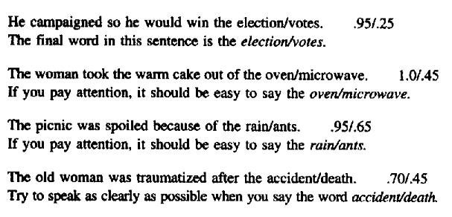
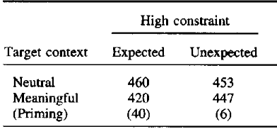
עדויות התנהגותיות לחיזוי/אינטגרציה
Traxler & Foss (2000)

Slide 4
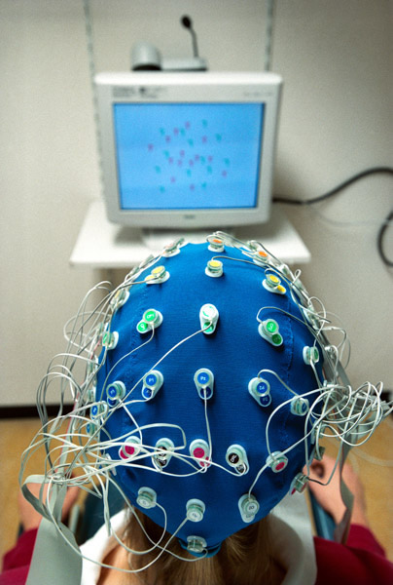
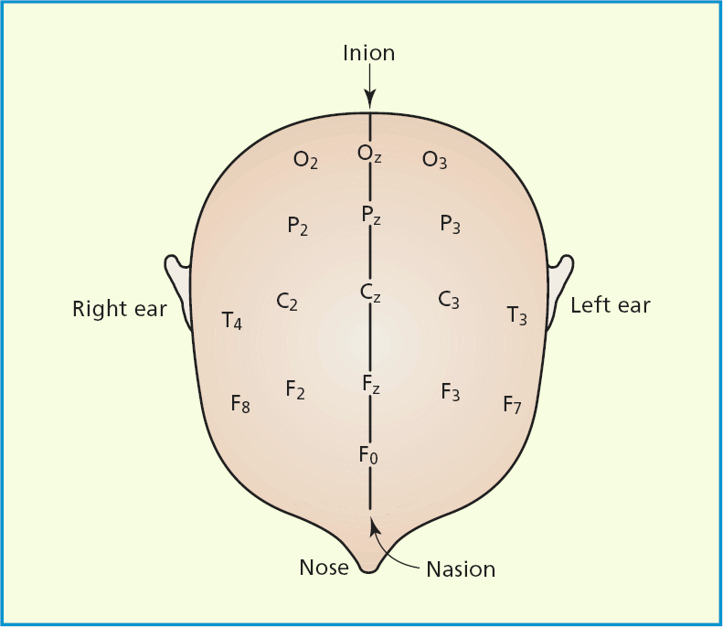
Electroencephalogram - EEG

Slide 5
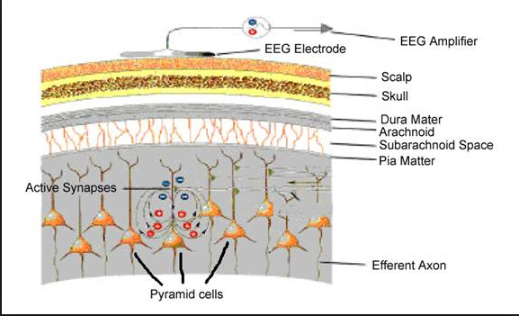
מקור הסיגנל החשמלי

Slide 6
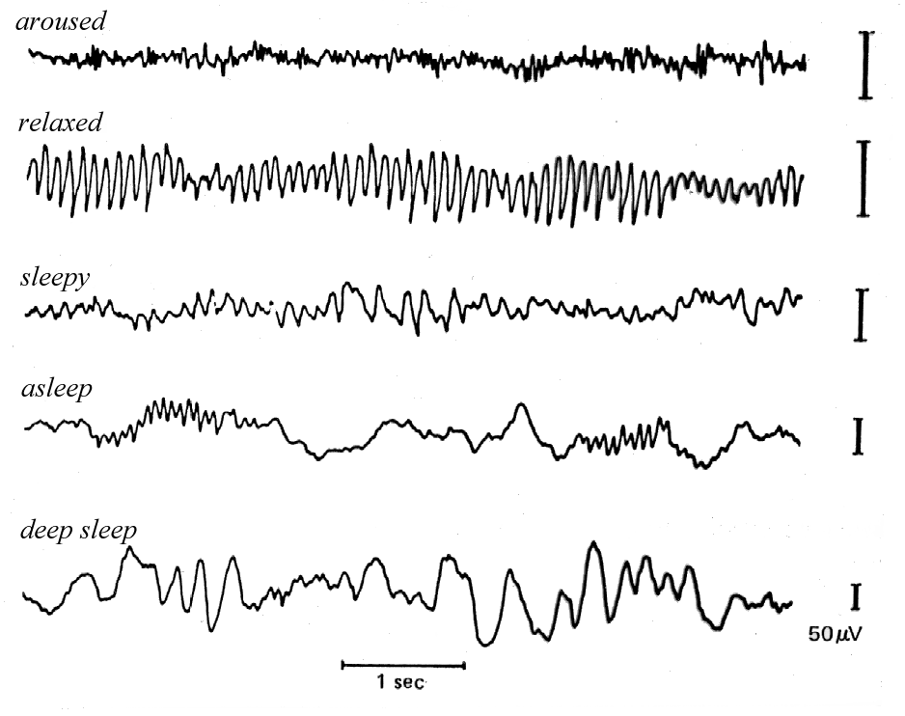
EEG ומצבי עוררות

Slide 7
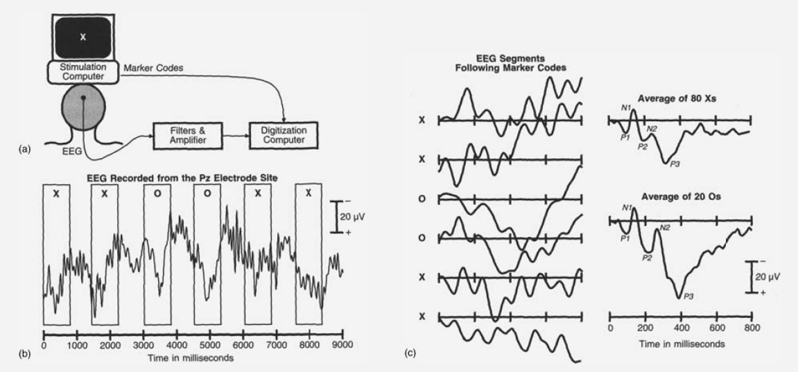
מ-EEG
ל-ERP- event-related potentials

Slide 8
רכיבי (קומפוננטות) ERP

Slide 9
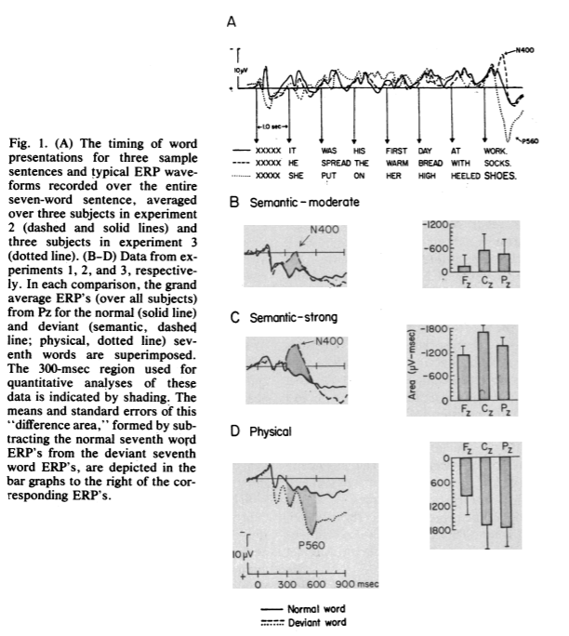
The N400: Kutas & Hillyard (1980)
N400 in response to anomalous words
a. She spread the warm bread with butter.
b. She spread the warm bread with socks.

Slide 10
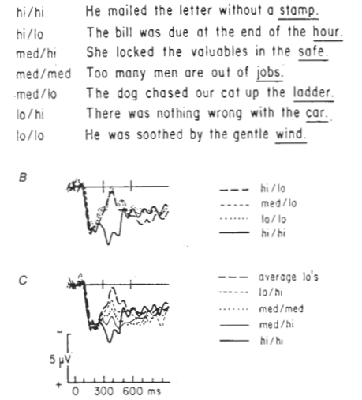
The N400: Kutas & Hillyard (1984)
N400 amplitude is inversely correlated with the word’s cloze probability
Every morning Dan drinks __
Coffee (80%)
Juice (10%)
Tea (6%)
Water (3%)
Beer (1%)

Slide 11
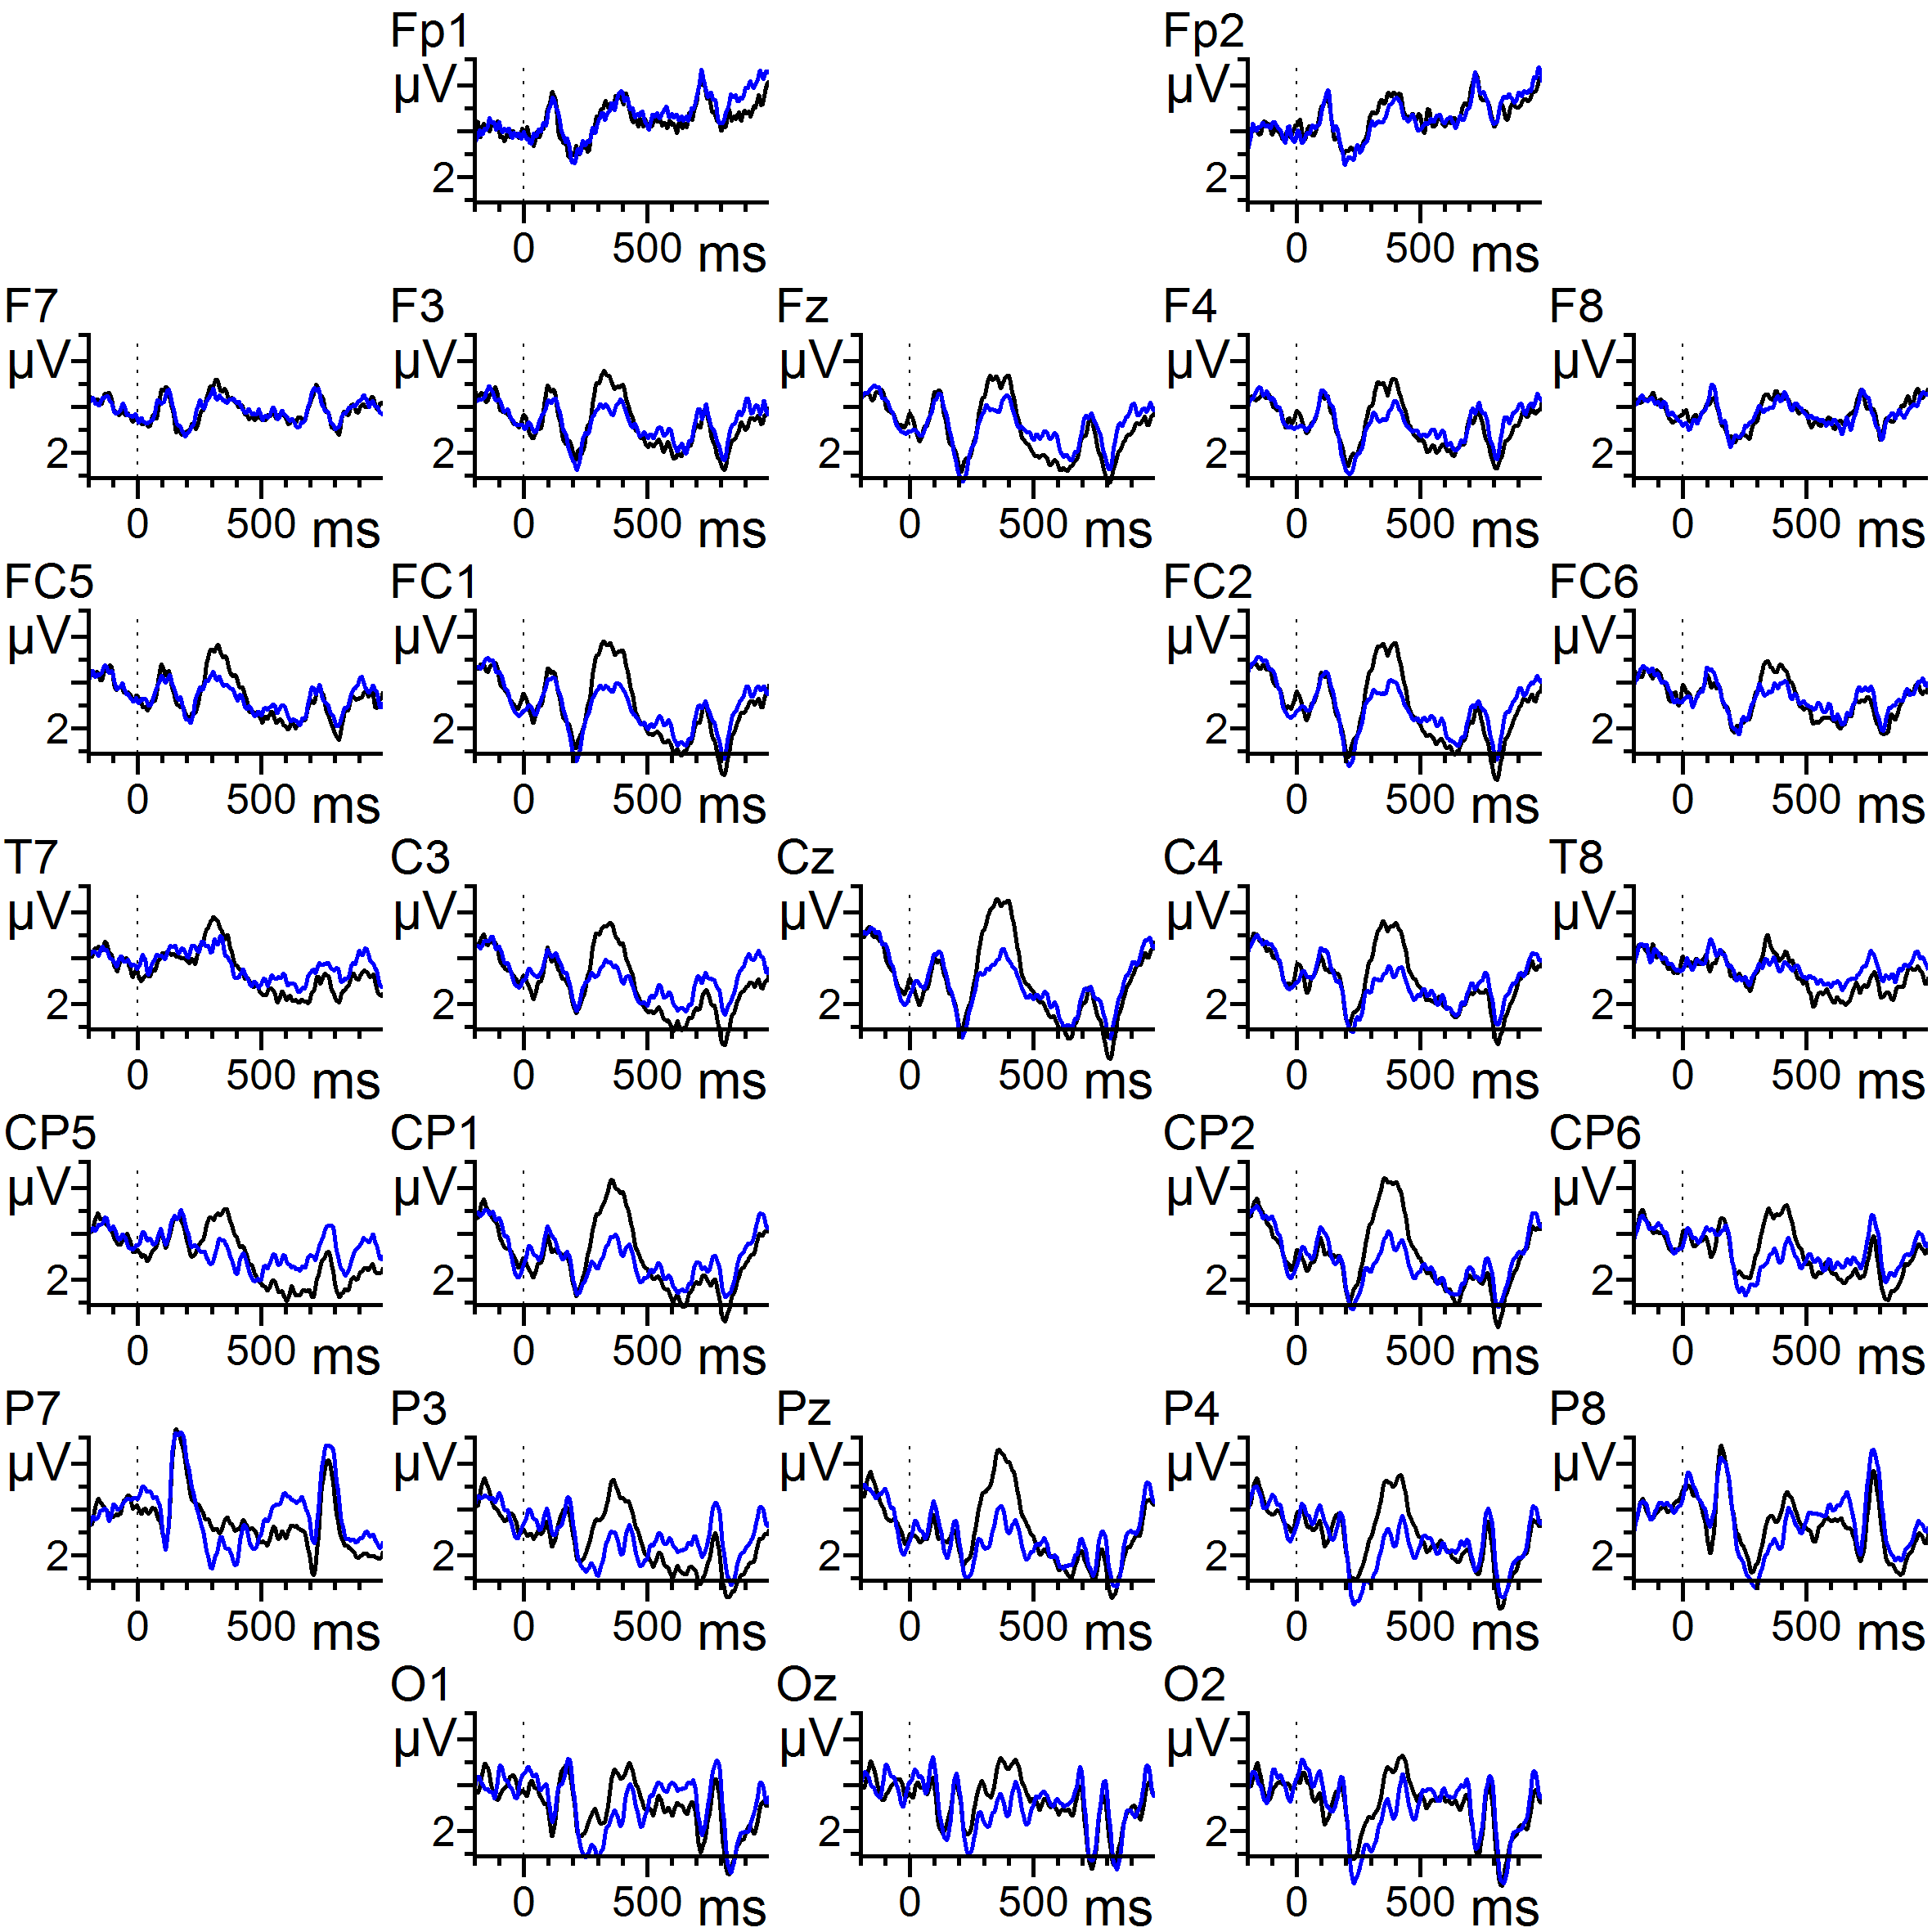
The N400: Ness & Meltzer-Asscher (2018)
Constraint | Sentence (translated from Hebrew)
High Low | ‘Since Ofir isn’t familiar with the library, the librarian helped him find ACC the book he needed’ ‘Ofir had searched for hours, but he couldn’t find ACC the book he needed’
 |  | Noun
High constraint
Low constraint

Slide 12
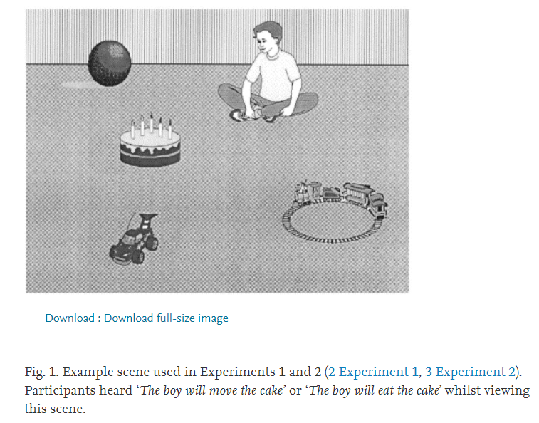
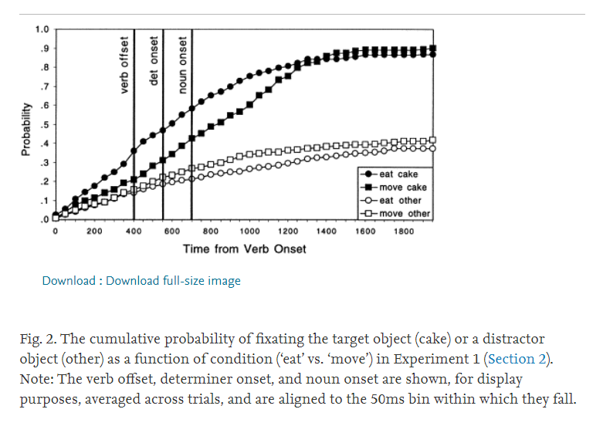
Evidence for prediction: Altmann & Kamide (1999), visual world eyetracking

Slide 13
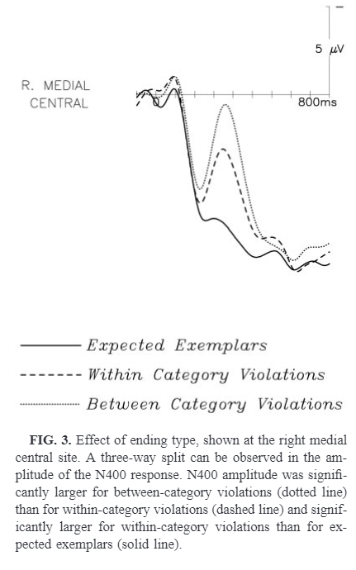

Evidence for prediction: Federmeier & Kutas (1999)

Slide 14
Evidence for prediction: Federmeier & Kutas (1999)
Conclusion: features of the predicted word are pre-activated

Slide 15
The current experiment
The day was breezy, so the boy went outside to fly …
  a kite (89% cloze probability)
  an airplane (5% cloze probability)
Sentences varying in constraint leading to expectations of words starting with consonant/vowel
Targets varying in cloze probability

Slide 16
The current experiment
The day was breezy, so the boy went outside to fly …
  a kite (89% cloze probability)
  an airplane (5% cloze probability)
N400 (kite) < N400 (airplane): can be due to prediction or integration

Slide 17
The current experiment
The day was breezy, so the boy went outside to fly …
  a kite (89% cloze probability)
  an airplane (5% cloze probability)
N400 (a) < N400 (an): can be due to prediction or integration
  The articles are not distinguished by how well they fit the event schema – their semantics is identical
  ‘a’ will only be easier to integrate
    If it’s easier to integrate shorter/more frequent words. In that case ‘a’ is predicted to elicit smaller N400 amplitude than ‘an’ regardless of context
    if readers had already formed an expectation for the word ‘kite’

Slide 18
Predictions
If the brain generates predictions of word forms probabilistically, then responses on the article are expected to be correlated with the article’s cloze probability (reflecting the predicted noun’s cloze probability)
If predictions are not generated, then responses on the articles (‘a’ and ‘an’)
  should not differ, as they are equally easy to integrate
  or ‘a’ should always be easier to integrate than ‘an’

Slide 19
Methods: Materials
80 sentence contexts, with either expected or unexpected (but congruent) indefinite article+noun
Each article+noun served as both expected and unexpected continuation, in different contexts
Latin square design
Equal number of expected/unexpected continuations and a/an in each list
25% of sentences followed by comprehension questions (near-ceiling performance)

Slide 20
Methods: Materials
Cloze probabilities
  for articles: obtained from 30 participants completing 80 sentences (cloze probabilities ranged from 0 to 96%)
    It was windy, so the boy went outside to fly…
  For nouns: obtained from 30 participants for each article (60 overall) (cloze probabilities ranged from 0 to 100%)
    It was windy, so the boy went outside to fly a…
    It was windy, so the boy went outside to fly an…
  Different participants than those in the ERP experiment

Slide 21
Methods: Participants
32 English speakers, ages 18-37

Slide 22
Methods: Procedure
Sentences presented one word at a time, with a 500 ms SOA (200 ms duration)
EEG recorded from 26 electrodes, referenced to averaged mastoids

Slide 23
Methods: Analysis
The 160 articles and nouns were sorted into ten bins according to cloze probability (0-10, 10-20, … 90-100)
Average N400 amplitude for the items in each bin was correlated with the mean cloze probability of the bin, for articles and nouns separately, for each of the 26 electrodes

Slide 24
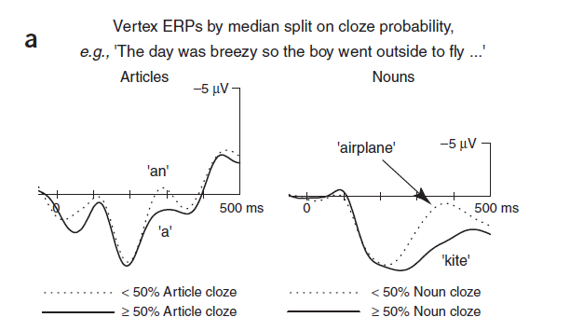
Results: Nouns

Slide 25
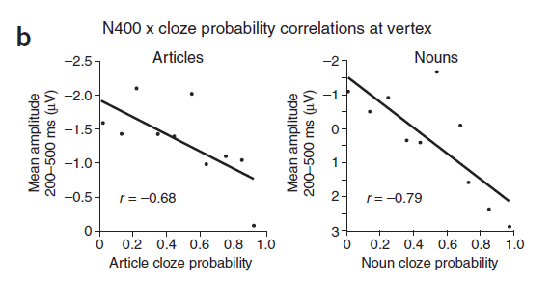
Results: Nouns

Slide 26
Results: Articles

Slide 27
Results: Articles

Slide 28
Nieuwland et al. (2018)
OSF | Replication Recipe Analysis plan

Slide 29
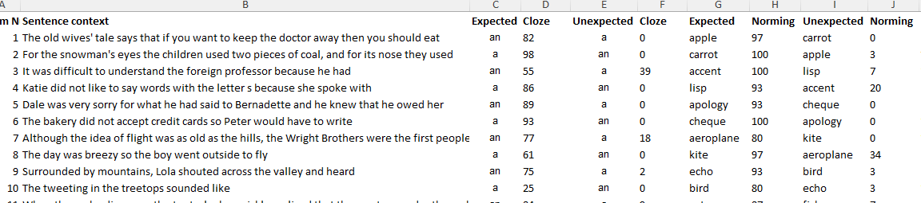
Materials

Slide 30
Materials
80 sentence contexts with two possible continuations each: a more or less expected indefinite article + noun combination. The noun was followed by at least one subsequent word.
Each article + noun combination served once as the more expected continuation and the other time as the less expected continuation.
160 items divided to two lists of 80 sentences such that each list contained each noun only once.

Slide 31
Participants and procedure
9 labs x ~40 participants per lab = 356 participants, right-handed, ages 18-35
Word by word presentation (200 ms presentation + 300 ms ISI)

Slide 32
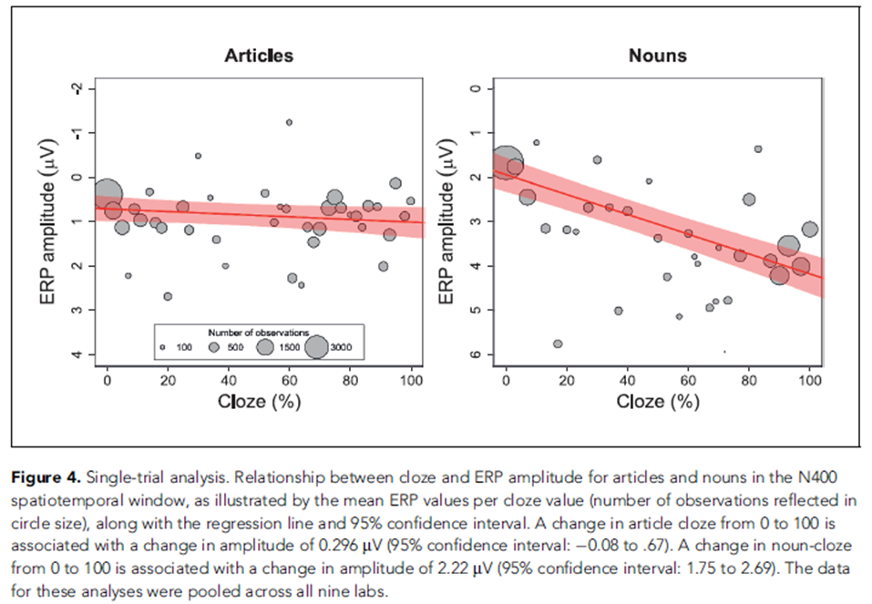
Results for N400

Slide 33




This research only looked at the N400, on articles and nouns

Slide 34
But there are additional things to look at

Slide 35




P600 at the verb

Slide 36
P600 at the verb
We previously found P600 on words that generate a strong prediction vs. those that do not
Constraint | Sentence (translated from Hebrew)
High Low | ‘In the library, the librarian helped Dan find the book he needed’ ‘Ofir had searched for hours, but he couldn’t find the book he needed’
P600
High constraint
Low constraint

Slide 37



P600 at the verb
Hypothesis to be tested: The higher the constraint of the sentence, the larger the P600

Slide 38
P600 at the verb
Problems/questions:
- Which constraint to use? The article or the noun constraint?

Slide 39
P600 at the verb
Problems/questions:
Which constraint to use? The article or the noun constraint?
  Noun constraint (constraint varies from a 100 to 23, not homogenesouly)
Time window for P600 is 500-900 ms after onset of word – already on next word
  Use segments which includes next word (article)
  Use only trials with expected ending so that we do not have effect of inhibition/reanalysis/surprise

Slide 40
To do
Read:
  Kutas et al. (2005)
  Nieuwland et al. (2018)
  Ness & Meltzer-Asscher (2018)
Get relevant segments:
  Only sentences with expected endings
  Verb segments:
    The verb begins 500 ms before onset of article
    Need segments that begin 500 ms before this and end 1000 ms after this
    The pre-stimulus period is for baseline correction
    I don’t think stimuli is already segmented for this – need to segment it from raw data

Slide 41
To do
Data preprocessing and analyses:
  Follow pre-processing stages as in Nieuwland et al. (code in OSF?)
  Follow analyses (linear model and correlation) as in Nieuwland et al., but for P600 instead of N400:
    Time window 500-900 (instead of 300-500 or whatever they did).
    Look at central and parietal electrodes (electrodes starting with C, CP, P) – not sure what electrodes they looked at.

